Slide 1

Details of participant:
Name: ANKAM. KESAV VENKAT
Roll No: 21FE5A0402
Branch: Electronics & Communication
College: Vignan’s Lara Institute Of Technology And Science
Year of Graduation: 2024

Slide 2
Describe the problem statement (200 words)
Now a days Gas leakages are a common problem in homes and industries. If not detected and corrected at the right time, it can causes lost of lives and properties. Potentially carbon monoxide is also very dangerous to life. A leakage of natural gas can be dangerous because it increases the risk of fire or explosion.
Local gas companies work hard to provide adequate warning in the event of a gas leak. Because methane and other natural gases does not have any odour, the gas company adds a warning “rotten-egg” smell (mercaptan or a similar sulfur-based compound) that can be easily detected by most people.
However, people who have a diminished sense of smell may not be able to rely upon this safety mechanism. Also the leak might occur at a time when no one is in the vicinity which increases the risk of an explosion.

Slide 3
Proposed solution / your big Idea (200 words)
When there is a chance of explosion , if there is a pre-intimation ( about the explosion )for the people who are present near by that area , then there is a chance of stopping that explosion or saving there lives and properties by moving away from that particular area.
And if any intimation is given to safety departments ( fire station , police station ,hospitals) there will be chance saving life’s and properties.
→ Here we are using Arduino technology ,embedded c language to develop code.
The main theme of this project is saving life’s and causing less damage. It can be done by :
By using Arduino uno board + MQ2 sensor +LCD Display + Relay + GSM + Camera + Connecting Wires
When MQ2 sensor detects the present of gas in a high range , then it gives buzzer and it indicates it in a LCD Screen ,
It also switches ON the relay connected to circuit which turn off all the power supply and automatically switches ON the power supply , it acts as MCB .
The circuit consists of GSM which sends an message & calls to given phone numbers ,and near by safety stations.
It also captures live photos when event was occurring .
By using all this features we can increase the safety for lives at the time of fire explosion due to leakage of gas.

Slide 4
How does your innovation accelerate change with the power of Technology?
(200 words)
The trend in gas sensor development is toward ease of use. As sensors become both cheaper and more reliably automated with digital technology, more people and organizations can install sensor networks and take control of the air and other gasses in their environment.
The gas sensor industry has primarily relied on analog gas sensing, but realizing the potential benefits of greater IoT connectivity will rely on mass digitization through the deployment of new digital sensors as well as updating older designs with analog to digital conversion capabilities.
The gas sensing element in a digitized gas sensor has to convert a physical parameter into an electrical signal that can be recorded and transmitted digitally.
Digital sensor platforms integrate analog sensing with digital electronics and a microhotplate onto a single die. This enables advanced signal processing circuits to create digital outputs that can be used without extra processing steps.
Miniaturizing gas sensors is high on the agenda for manufacturers as well. MEMS-based technology could put a gas sensor inside a smartphone, putting sensing capabilities literally into the hands of the general public. Carbon nanotube inks printed on thin films are one example of miniaturization in the gas sensor industry.
The result of these development trends will be to acquire more data on air quality, pollution, carbon dioxide emissions, and a host of other important factors than ever before.

Slide 5
How is your solution different/unique from other solutions in market (150 words)
In present scenario , when ever the gas is detected there is only buzzer(alarm) sound come’s, but my project has additional features like
Displaying amount of gas present in the specific area
Switching ON & OFF the electricity based on gas levels
Giving intimation to near by Fire stations , Police stations, and other safety departments , by a call and messages and it will also send live location and pictures of live incident ,with gas values.
Rise a buzzer( loud siren ) in surroundings.
I also created a working prototype by using Arduino uno and other components . It is working in excellent condition , and I’m also ready to submit it .
Do you have a working model/prototype: Yes/No
If not, will you be able to show working prototype during finale. Yes/No

Slide 6

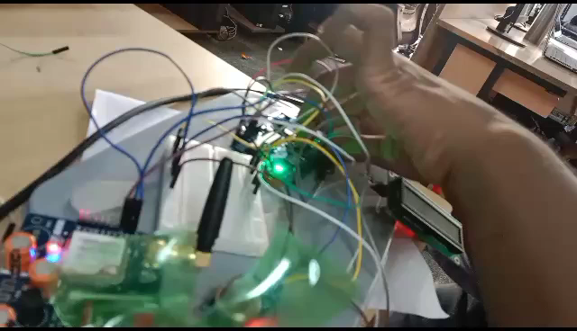
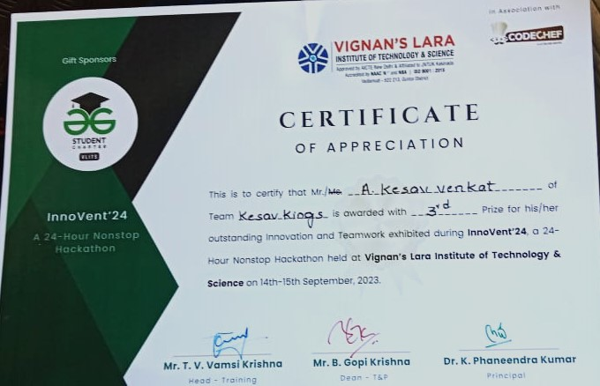
Any testimonials received?
In Vignan’s Lara Institue of Technology & Science , An event named Innovent’24 ( 24-hour Non stop Hackathon ) was held on 14th-15th September, 2023. I submitted this project in it , I was appreciated with 3rd prize and I won 1000 rupees cash prize for my innovation idea.
And I explained this project to an K. Vijaya Vardhan ( Assistant professor ) in Vignan’s Lara Institute of Technology & Science , he also checked how it is working and appreciated me.
Award Receiving
Test-1 sample video
Certificate

